Slide 1
Infrastructure Based WLAN
Name : Sumit
Roll No : 59

Slide 2
Overview
In infrastructure mode, the WLAN network is composed of stations as well as one or more access points(APs).
All the communications between stations will go through an access point.
Each access point forms a radio cell, also called a basic service set (BSS).
The wireless WLAN network with one AP is referred to as BSS(Basic Service Set). When more than one AP’s are available in a network to form a sub-network, it is referred as ESS(Extended Service Set).

Slide 3
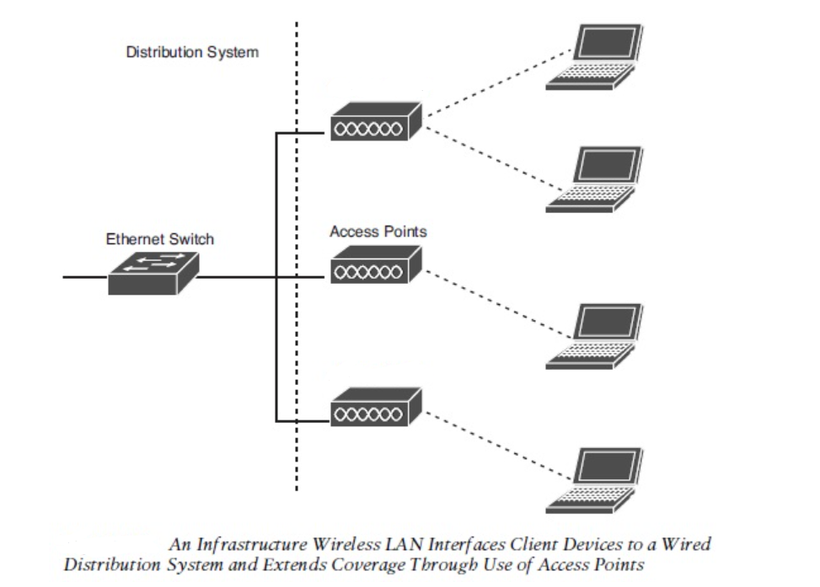
Infrastructure

Slide 4
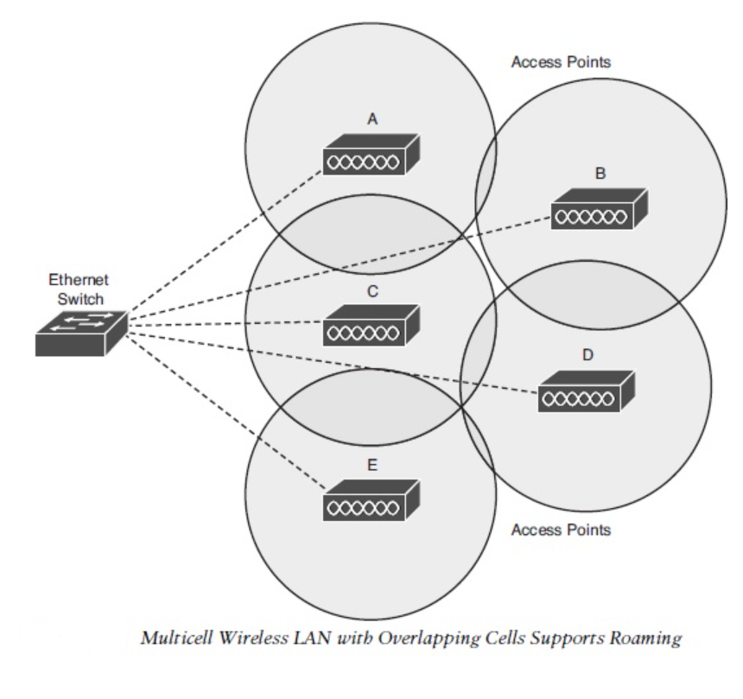
Roaming

Slide 5
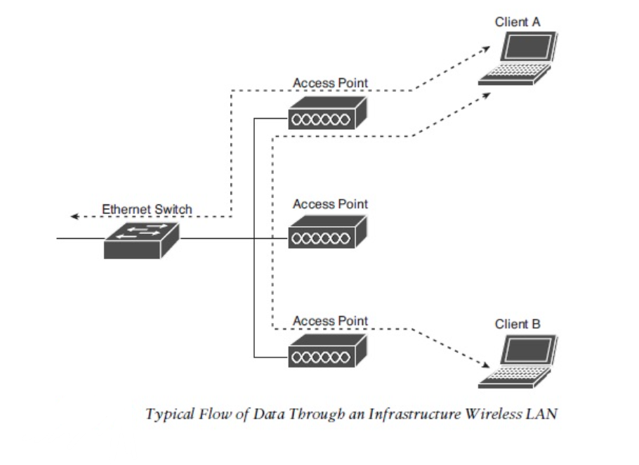
Communication

Slide 6
References
https://forum.huawei.com/enterprise/en/what-is-wlan-infrastructure-mode/thread/746009-869
https://www.networkcomputing.com/wireless-infrastructure/wireless-lan-models

